Slide 1

Project of Software Engineering 2: “my Taxi Service” Reference professor: Raffaela Mirandola
Politecnico di Milano
Computer Science and Engineering
Author: Andrea Maioli (mat. 852429)

Slide 2
Requirements Analysis and Specifications

Slide 3
The Given Request
Design an application that is able to manage taxi requests.
Given constraints:
Fair management of taxi queues.
Service accessible from both mobile and web application.
Passenger must be informed with code of incoming taxi and waiting time.
Taxi driver can accept/decline requests via mobile application.
Division of the city in zones, and for each zone one queue.
The system must provide an API to enable development of future additional services.

Slide 4
Assumptions (Main points)
There is an existsing call center infrastructure that will not be discontinued.
Drivers and Call Center operators are directly hired from the government and are considered public employees.
If a driver is not assigned to a request, he/she can pick up a passenger (as taxi normally does).
City: Milan (3.2 Millions of people).
Number of drivers: 5.000 (due to last Corriere Della Sera analysis).
The number of requests never saturare the available taxies.

Slide 5
Actors: who will use the new system?
Guest: a non register user.
Passenger: registered user who will use the system for requesting a ride.
Call Center Operator: special registered user who will handle the request coming from the telephone and instert them into the system.
Taxi Driver: special registered user who will bring to completion the requests coming from passengers.
Administrator: is a special user with the right to modify the information stored inside the system.

Slide 6
Goals of the new system
Simplify the access of passengers to the taxi service.
Guarantee a fair management of the taxi queue.
Simplify the communications between drivers and call center.
Simplify the methods of access to the requests for the taxi drivers.
Allow the system to manage events and requests.
Allow the administrator to handle area and user’s informations.

Slide 7
Future Implementations
Creation and tuning of a specific algorithm for dynamic taxi allocation
After a year of data collection will be possible to analyze the relation between the number of request in a specific hour of a specific day with:
hosted events
the weather type
the day of the week.
Will help predict the estimated density of request per area, and accordingly increase/decrease the number of taxi presents in all the areas.

Slide 8
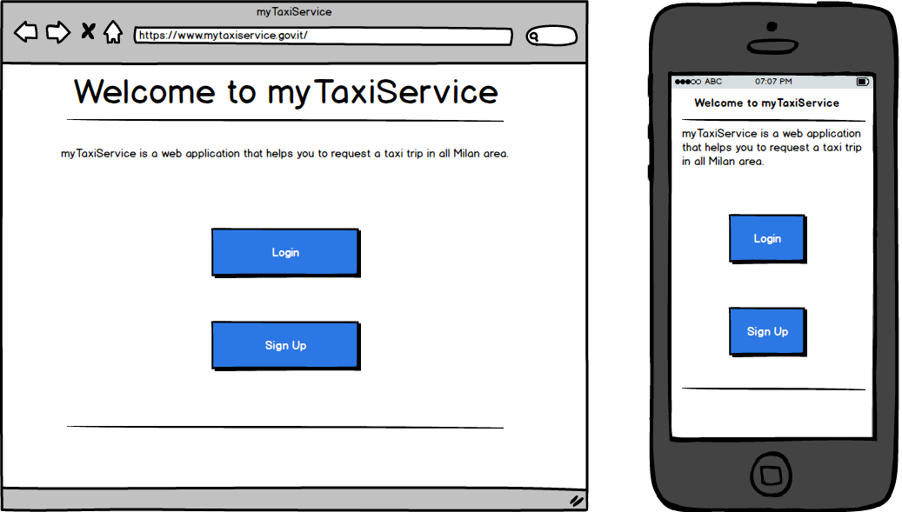
User Interface – Home Page

Slide 9
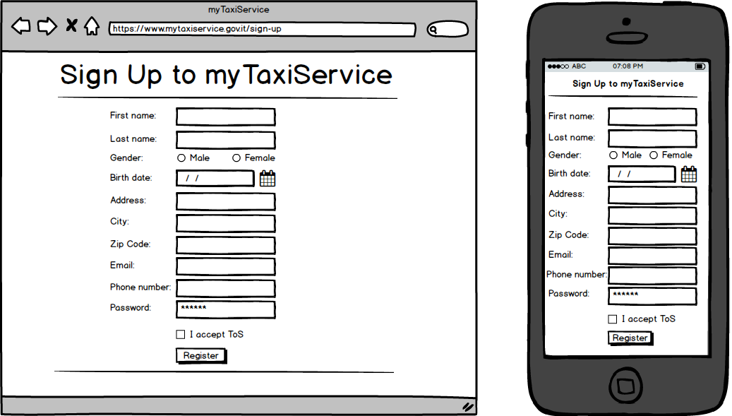
User Interface – Sign Up Page

Slide 10
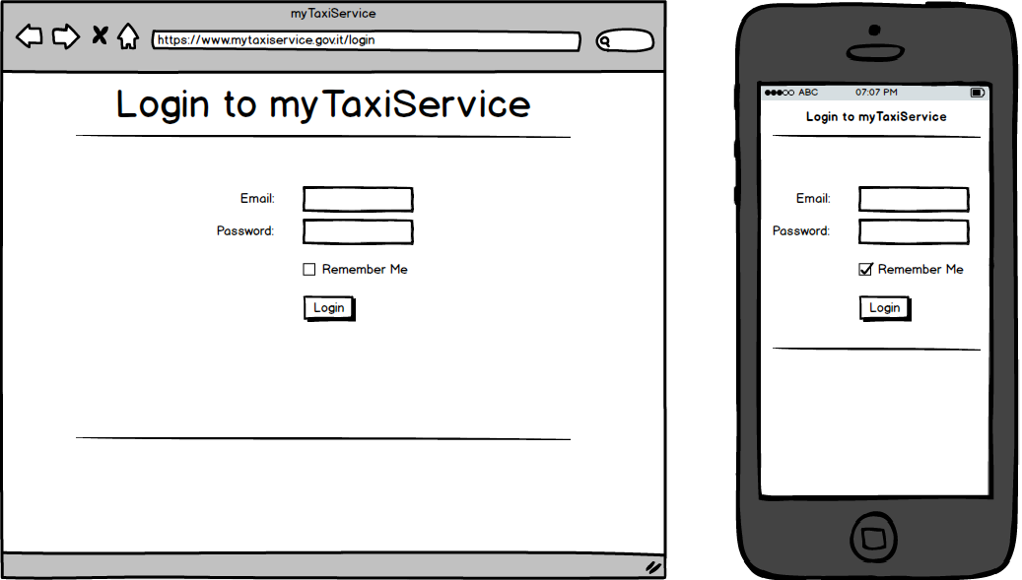
User Interface – Login Page

Slide 11
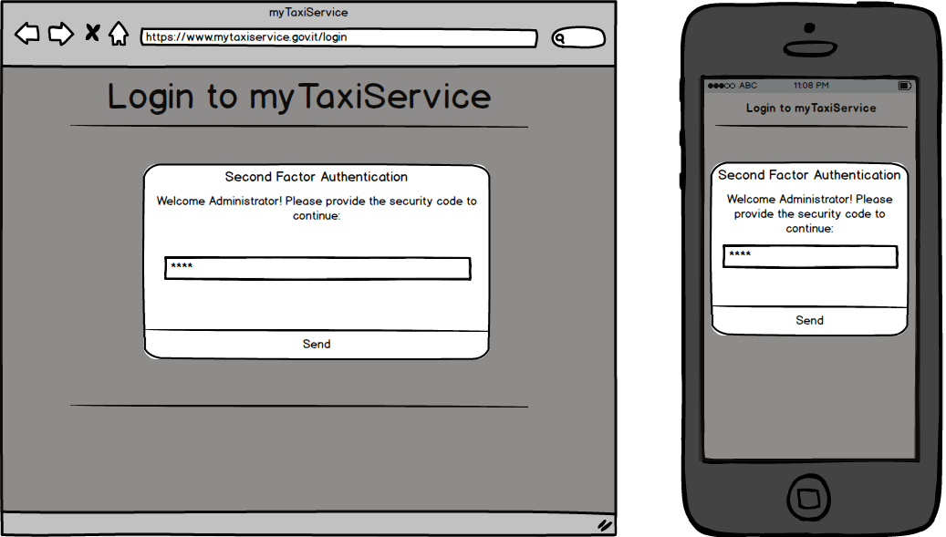
User Interface – Administrator Login Page

Slide 12
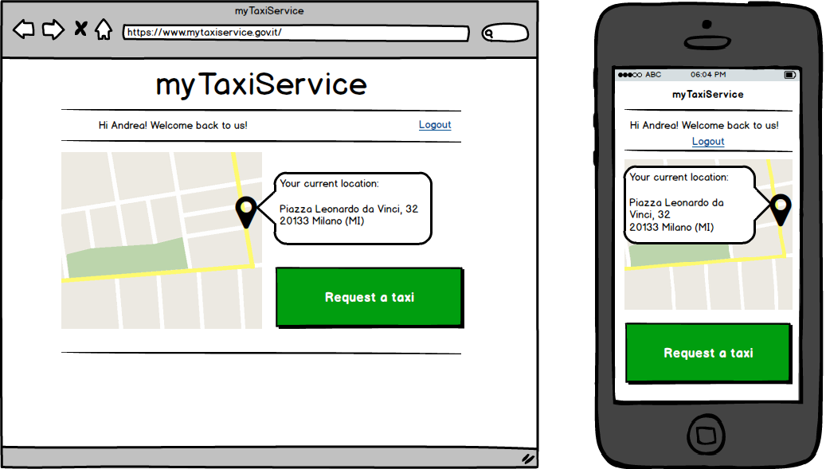
User Interface – Passenger Home Page

Slide 13
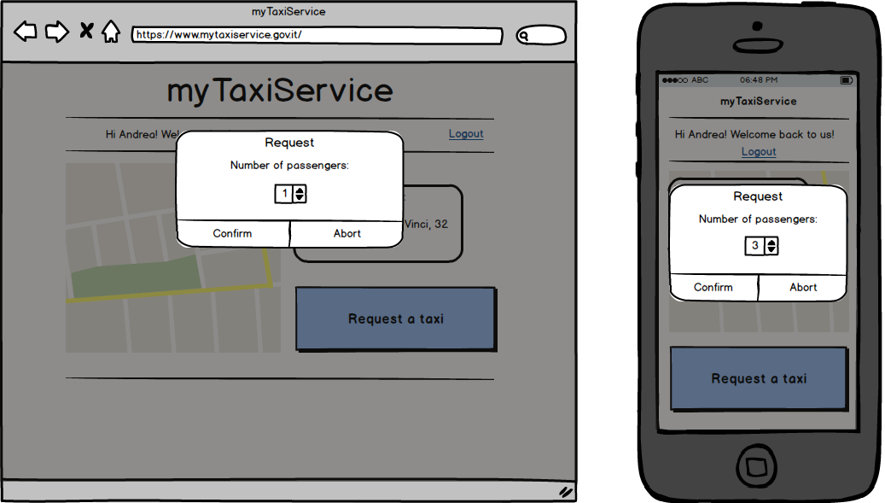
User Interface – Taxi Request

Slide 14
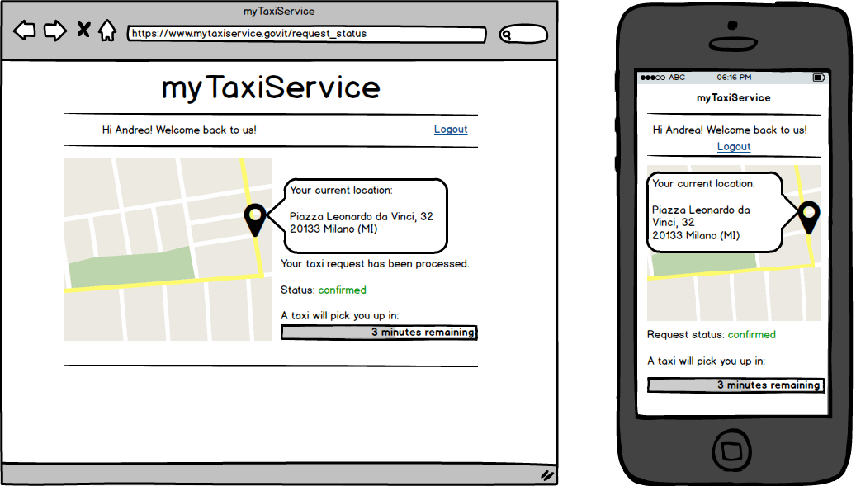
User Interface – Active Request Page

Slide 15
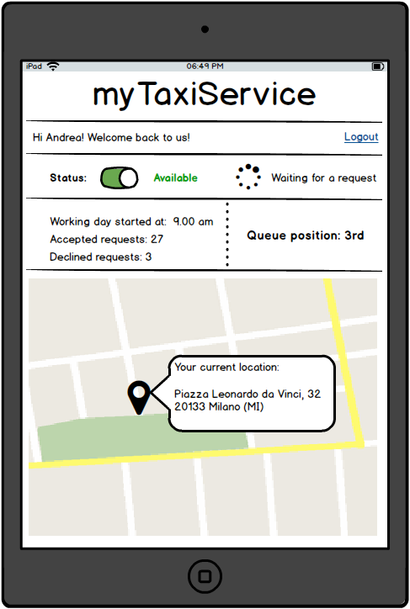
User Interface – Driver Home Page

Slide 16
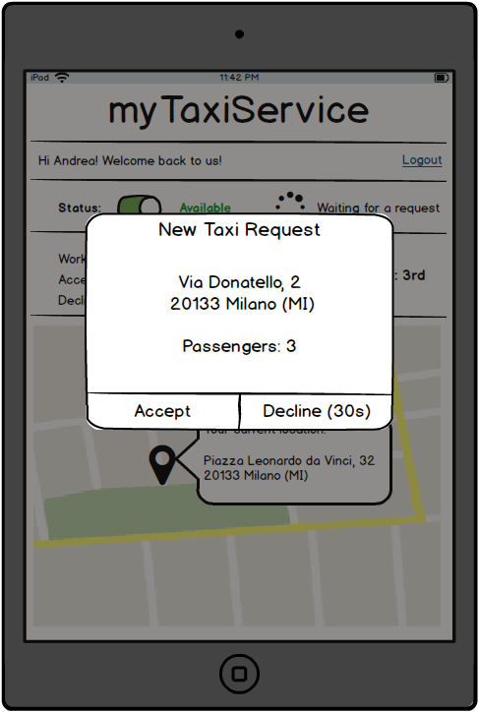
User Interface – Incoming Request

Slide 17
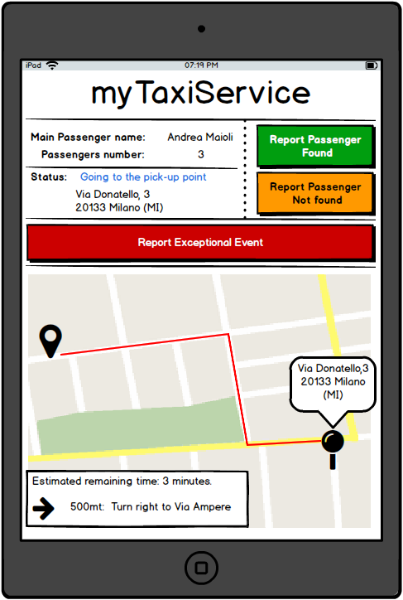
User Interface – Driver Active Request Page

Slide 18
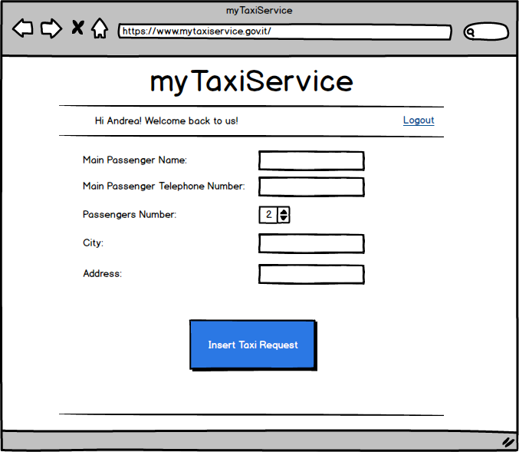
User Interface – Operator’s Home Page

Slide 19
Functional Requirements
Guest can:
Sign Up
Passenger can:
Login
Modify profile information
Request a taxi
Get the status and ETA of an active request
Logout

Slide 20
Functional Requirements
Driver can:
Login
Update the status
View queue position and workday statistics
Receive and respond to taxi request
Report if a passenger is found or not
Report an exceptional event which prevent him/her to get to the pick-up point
Get ETA to the pick-up point and indications
Logout

Slide 21
Functional Requirements
Call Center Operator can:
Login
Insert in the system a taxi request
Get the status and ETA of the inserted request
Logout

Slide 22
Functional Requirements
Administrator can:
Login on the web application
Create, delete or modify an area
Modify or delete an user
Modify the user level (can be driver, call center operator)
Logout

Slide 23
Functional Requirements
The system must be able to:
Assign a request to the first taxi in the queue.
Organize drivers in queue.
Forward a request to the second driver in the queue if the first driver decline it.
Assign a new driver to a request, if the assigned driver report an exceptional events.
If no driver is available in a queue, the system must be able to find the driver that will arrive to a fixed pick-up point in the less possible time.
The driver can be one from another area, or one that will finish a ride in the request’s area.

Slide 24
Performance Requirements
The system must be able to compute the response to each request in no more than 0.5s.
The system must be able to serve simultaneously at least:
1600 taxi drivers
50 call center operators
110 passengers
With a total response time for each action lower than 3 seconds.

Slide 25
Software System Attributes
Availability:
24 hours per day, 7 days per week.
Security:
User’s credential stored using a hashing function.
User’s password must a combination of letters and numbers and at lest 8 characters long.
The Application Server must be the only machine able to communicate with the Database Server.
All the user inputs must be filtered in order to prevent SQL-Injection, Cross Site Scripting and other type of attacks.
HTTPS must be enable on the web server and all the connection coming from the HTTP protocol must be redirected to the HTTPS one.

Slide 26
Software System Attributes
Maintainability:
Each function and class of the application must be well commented in order to allow future developers to understand and modify the code.
Each update or modification to the application or the infrastructure must be traceable and well documented.
Each solution to every future problem must be well documented, in order to know how it was solved.
Each method provided by the API must be well documented and some example must be provided.
(as ITIL suggests)

Slide 27
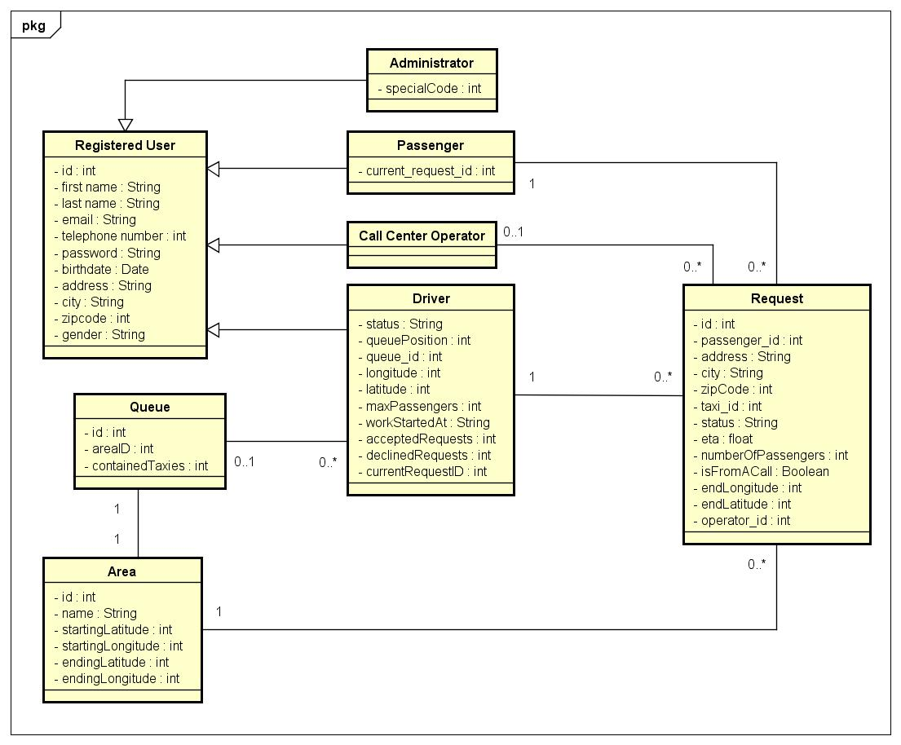
Class Diagram

Slide 28
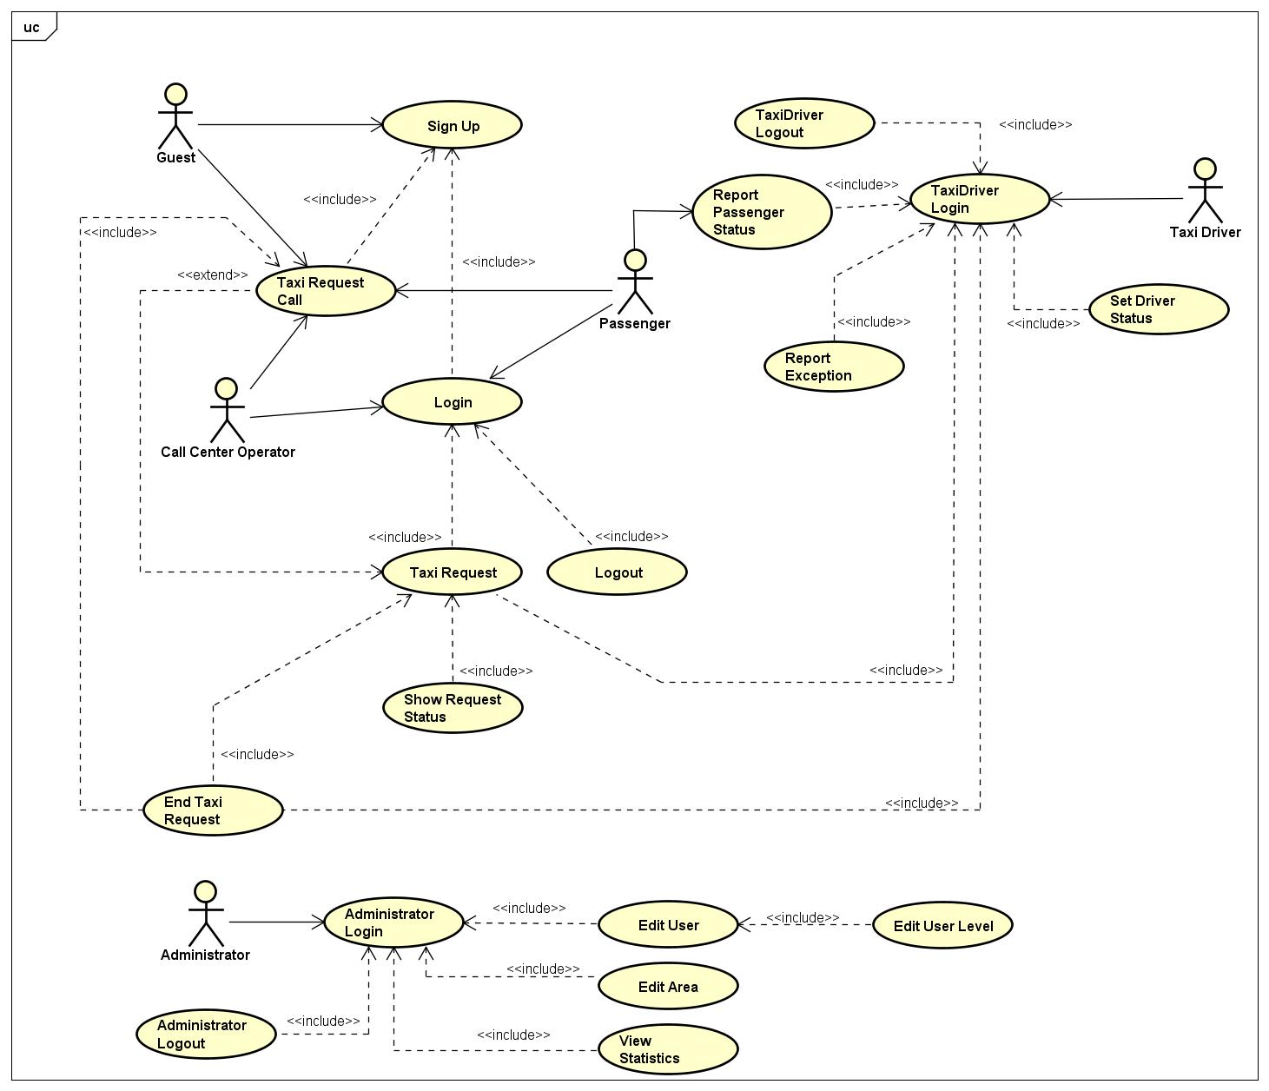
Use Case Diagram

Slide 29
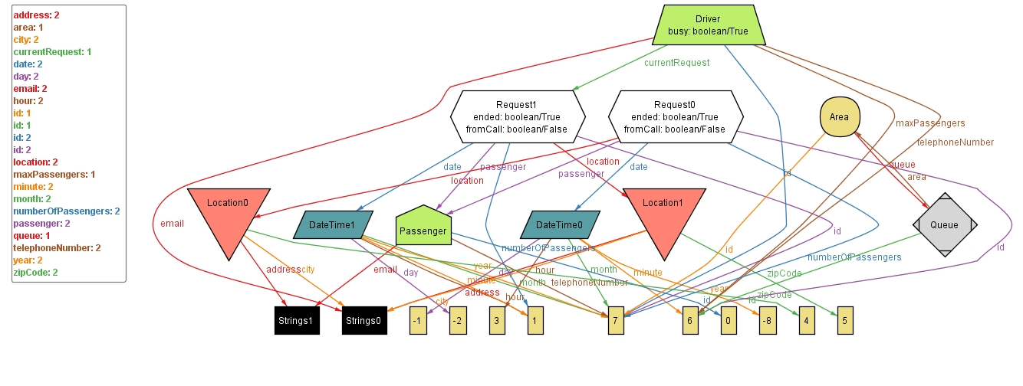
Alloy – Generated World
Alloy code is available in the documentation, with tests results.

Slide 30
Design

Slide 31
Architectural Design – Overview
The project is based on the Java Enterprise Edition (JEE) architecture.

Slide 32
Architectural Design – High Level Components
Database Server:
Contains the application data and information used by the entire system.
Will consist in a DBMS which is MySQL.
Application Server:
Contains all the application logic of the system and manages all the actions inside it.
Will use Java Persistant API (JPA) and Java Entity Beans.
Run by Glassfish Server.

Slide 33
Architectural Design – High Level Components
Web Server:
Provides a web interface to access the system using a web browser and exposes a RESTful API used by the mobile application to interact with the system.
Will use JAX-RS to provide the RESTful API and Java Server Faces (JSF) to provide a web interface.
Run by Glassfish Server.
Client:
Represented by a web browser and the mobile application (available on Android, iOS and Windows Phone).

Slide 34
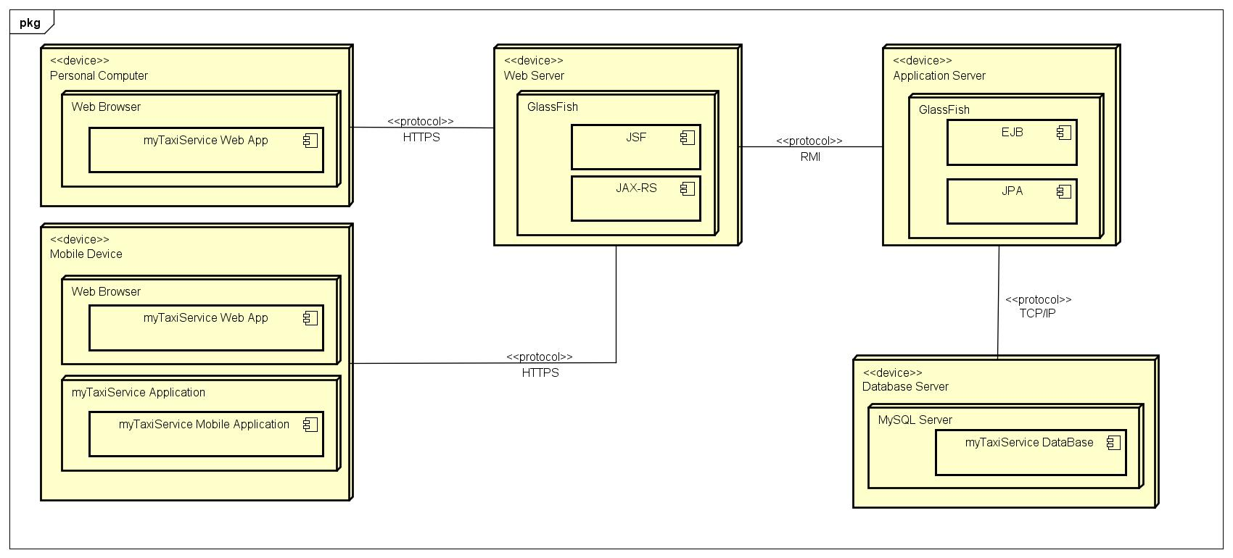
Architectural Design – Deployment Diagram

Slide 35
Architectural Design – Software Components
Application Server Components:
Request Manager: provides all the functionalities required to create and manage taxi requests.
(e.g.: create a request)
Queue Manager: provides all the functionalities required to manage a queue.
(e.g.: remove a taxi from the queue)
Account Manager: provides all the functionalities required to manage an account.
(e.g.: register, login)
Location Manager: provides all the functionalities required for handling geographic coordinates and taxi’s areas.
(e.g.: get area of a location, computing the time required to arrive to a place)
Taxi Manager: provides all the functionalities required to manage a taxi.
(e.g.: update its status)

Slide 36
Architectural Design – Software Components
Web Server Components:
Web Server Controller: is in charge of the invocation of the methods provided by the API exposed by the Application Server.
This component will also manage both the request through the provided RESTful API and the Website.
The Database Server does not implement any application logic.

Slide 37
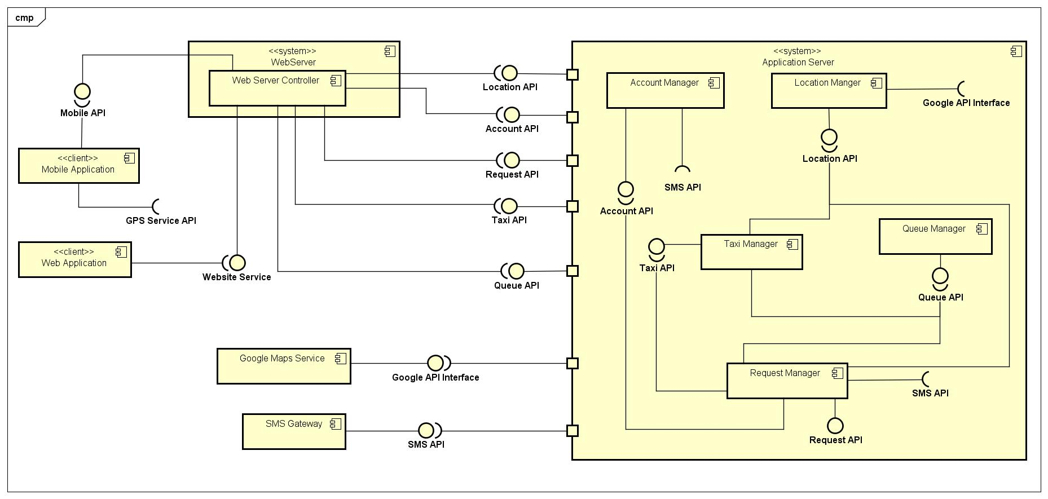
Architectural Design – Components View

Slide 38
Architecture Styles and Patterns
Model View Controller
Client-Server is applied in communication between components.
REST API

Slide 39
Other Design Decisions
Amazon EC2 with Elastic Load Balancing:
Automatic scalable and load-balancing based cloud computing, resulting in a better flexibility, lower costs that are directly related to usage, better availability and better fault tolerance.
Polling Requests from Clients
The client will continuously send a request to the web server in order to receive and update informations.
InnoDB as storage engine for MySQL
More resistant to table corruption than other storage engines.
Grant an higher level of concurrency (better performance).

Slide 40
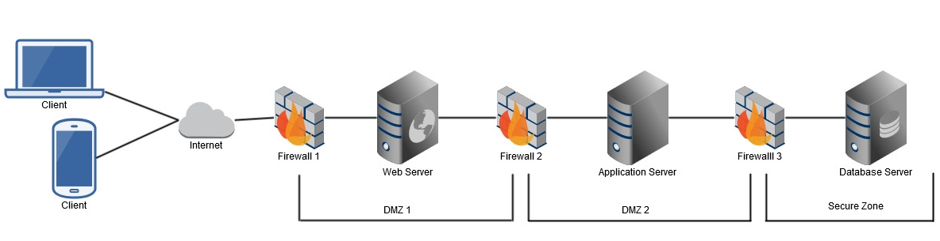
Other Design Decisions: Security
Two Factor Authentication for Administrators Login
Slow Hashing Function and Salt for Password
Slow down bruteforce attack
Usage of pre-build hashing tables not possible.
Firewalls
Configured on a default deny base.

Slide 41
Integration Testing Plan

Slide 42
Integration Testing Strategy
Two phases:
1) Integration between components that compose the same subsystem.
2) Integration of different subsystems
Bottom-up approach
Nature of the system: different components relies on other.
No useless stubs.
Integration will start from the components with the minimum number of dependencies.

Slide 43
Integration Sequence
Software

Slide 44
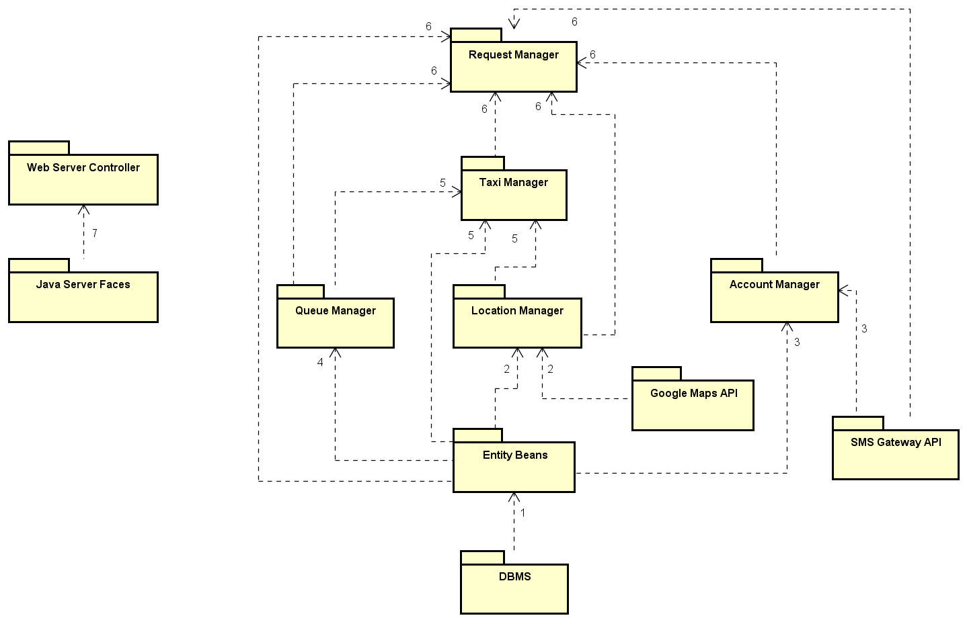

Slide 45
Integration Sequence
Subsystems

Slide 46
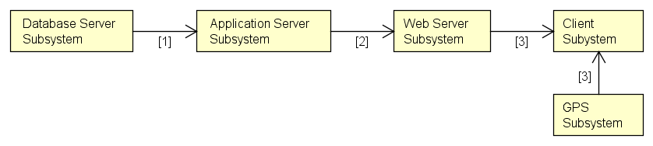
Integration Sequence - Subsystems

Slide 47
Example Of Test Cases
Test Case Identifier | I1T1
Test Item(s) | DBMS → Entity Bean “Area”
Input Specification | Typical query on the table “Area”.
Output Specification | All the requested operations are made on the table and all the expected data is returned from the query.
Environment Needs | Testing Database, Glassfish Server, Driver for the Entity Bean
Purpose | This test check if the called methods of the Entity Bean “Area” execute the expected query on the DBMS.
Test Case Identifier | SI2T1
Test Item(s) | Application Server Subsystem → Web Server Subsystem
Input Specification | The Web Server Subsystem calls the Remote EJB on the Application Server Subsystem.
Output Specification | The action seen on the system is the expected one.
Environment Needs | Glassfish Server, Application Server’s software components must be completed, driver for the Web Server Subsystem (can be a Browser)
Purpose | This test checks if the Web Server and the Application Server can properly communicate without errors, and verify if the expected actions are performed on the system.
All test cases are available in the documentation.

Slide 48
Project Plan

Slide 49
Function Points Analysis
FP Type | FP Count
Internal Logic Files | 46
External Interface Files | 20
External Inputs | 90
External Outputs | 17
External Inqueries | 16
Total: | 189
SLOC = 53 * FP_Count: | 10017
The complete analysis of the functional points is available in the documentation.
Java Multiplier for SLOC is 53

Slide 50
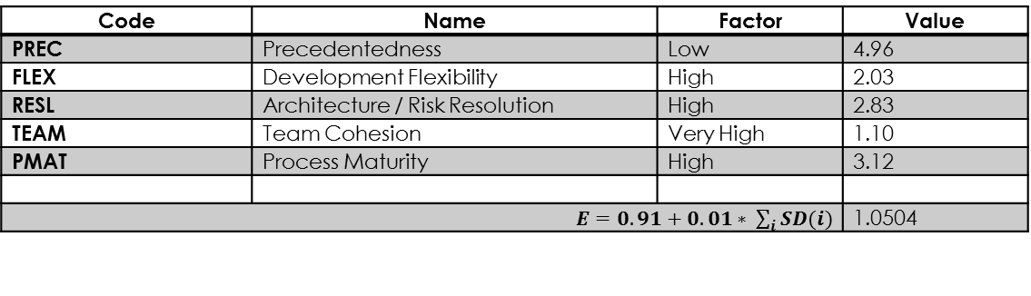
COCOMO II – Scale Drivers
Code | Name | Factor | Value
PREC | Precedentedness | Low | 4.96
FLEX | Development Flexibility | High | 2.03
RESL | Architecture / Risk Resolution | High | 2.83
TEAM | Team Cohesion | Very High | 1.10
PMAT | Process Maturity | High | 3.12
$E=0.91+0.01∗ \sum_{i}{SD(i)}$ |  |  | 1.0504
PREC is set to to “Low” because there is no enough experience with the used technology and the design skills achieved until now are not enough.
FLEX is set to “High” because there are some goals and some general key-point defined, but there is also a good level of flexibility.
RESL is set to “High” due to the risks analysis done.
TEAM is set to “Very High” because the hired developers will have a good level of experience in working in team.
PMAT is set to “High” because the correspondent CMM level is 3.
The complete analysis of the drivers is available in the documentation.

Slide 51
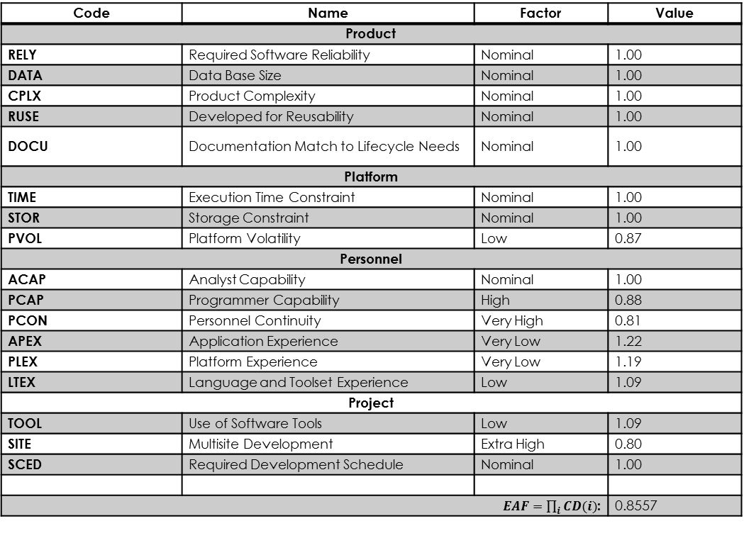
COCOMO II – Cost Drivers
Code | Name | Factor | Value
Product
RELY | Required Software Reliability | Nominal | 1.00
DATA | Data Base Size | Nominal | 1.00
CPLX | Product Complexity | Nominal | 1.00
RUSE | Developed for Reusability | Nominal | 1.00
DOCU | Documentation Match to Lifecycle Needs | Nominal | 1.00
Platform
TIME | Execution Time Constraint | Nominal | 1.00
STOR | Storage Constraint | Nominal | 1.00
PVOL | Platform Volatility | Low | 0.87
Personnel
ACAP | Analyst Capability | Nominal | 1.00
PCAP | Programmer Capability | High | 0.88
PCON | Personnel Continuity | Very High | 0.81
APEX | Application Experience | Very Low | 1.22
PLEX | Platform Experience | Very Low | 1.19
LTEX | Language and Toolset Experience | Low | 1.09
Project
TOOL | Use of Software Tools | Low | 1.09
SITE | Multisite Development | Extra High | 0.80
SCED | Required Development Schedule | Nominal | 1.00
$EAF=\prod_{i}{CD(i)}$: |  |  | 0.8557

Slide 52
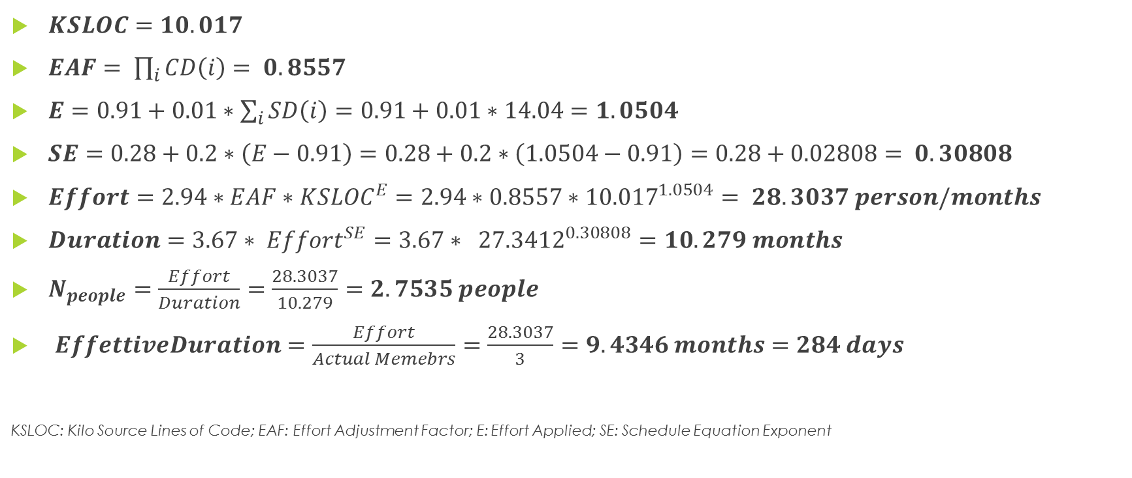
COCOMO II – Results of Analysis
$KSLOC=10.017$
$EAF= \prod_{i}{CD\left(i\right)= 0.8557}$
$E=0.91+0.01∗\sum_{i}{SD\left(i\right)}=0.91+0.01∗14.04=1.0504$
$SE=0.28+0.2∗\left(E−0.91\right)=0.28+0.2∗\left(1.0504−0.91\right)=0.28+0.02808= 0.30808$
$Effort=2.94∗EAF∗{KSLOC}^{E}=2.94∗0.8557∗{10.017}^{1.0504}= 28.3037 person/months$
$Duration=3.67∗ {Effort}^{SE}=3.67∗ {27.3412}^{0.30808}=10.279 months$
$N_{people}=\frac{Effort}{Duration}=\frac{28.3037}{10.279}=2.7535 people$
$EffettiveDuration=\frac{Effort}{Actual Memebrs}=\frac{28.3037}{3}=9.4346 months=284 days$
KSLOC: Kilo Source Lines of Code; EAF: Effort Adjustment Factor; E: Effort Applied; SE: Schedule Equation Exponent

Slide 53
Tasks and Schedule
Task ID | Task Description | Starting Date | Deadline | Duration | Status
T.01 | Creation of the Requirement Analysis and Specification Document (RASD) | 15/10/2015 | 06/11/2015 | 23 Days | Done
T.02 | Creation of the Design Document (DD) | 07/11/2015 | 04/12/2015 | 28 Days | Done
T.03 | Creation of the Integration Testing Plan Document (ITPD) | 07/01/2016 | 21/01/2016 | 15 Days | Done
T.04 | Creation of the Project Plan Document (PPD) | 22/01/2016 | 02/02/2016 | 12 Days | Done
T.05 | Creation of the slides for the Project Presentation | 03/02/2016 | 23/02/2016 | 21 Days | To Be Done
T.06 | Presentation of the slides to the stakeholders | 24/02/2016 | 24/02/2016 | 1 Days | To Be Done
T.07 | Apply changes to the project documentation, if required | 25/02/2016 | 27/02/2016 | 3 Days | To Be Done
T.08 | Implementation | 28/02/2016 | 23/12/2016 | 300 Days | To Be Done
T.09 | Integration Testing | 24/12/2016 | 7/01/2017 | 15 Days | To Be Done
T.10 | Deployment | 8/01/2017 | 12/01/2017 | 5 Days | To Be Done

Slide 54
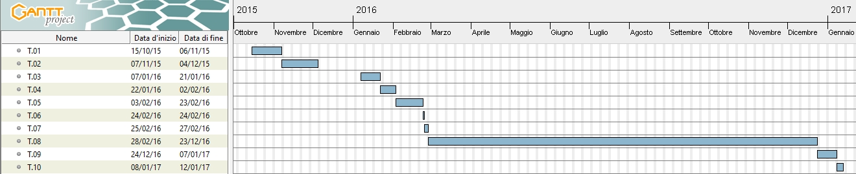
Gantt Diagram

Slide 55
Risks Analysis
Project Risks:
Delays over the planned deadlines (High Probability, Medium Effect)
Contromeausure: release application without less essential features.
Requirements change (Very Low Probability, Medium Effect)
Contromeasure: the developed code must be easily extensible.
Lack of Experience (High Probability, Medium Effect)
Temporary Unavailability of personnel involved in critical tasks (Medium Probability, Medium Effect)
Contromeasure: reorganize the resource allocation
Technical Risks:
Data loss (Very Low Probability, Very High Effect)
Contromeasure: backup of all data into a dislocated region.
Data Leaks and security issues (Very Low Probability, Very High Effects)
Contromeasure: identify and fix the component that causes the data leaks; Also verify the configuration of each service.

Slide 56
Risks Analysis
Business Risks:
Bad estimation of Project Costs (Medium Probability, Medium Effect)
Contromeasure: allocate more economical resources to the project or downscale the project size.

Slide 57
Questions?

Slide 58
Thank You

